Slide 1
WRWV201 Capstone project
Designing and creating a website – from scratch, from beginning to end

Slide 2
Web site design process
In lecture 1 we said:
Web site creation is more than
“Just throw all the buttons on the screen....” / “fill the screen with stuff”
Web sites are usually NOT created FOR the designer/coder – you are doing it for a client
So listen to the client
Keep the audience in mind

Slide 3
Web site design process
Get the topic
Investigate the topic and the target audience
Plan designs which suits the topic and the target audience
Design process needs planning for
Content
Interaction
Presentation
Discuss the designs with the project leader/client, decide on which design to implement, how to adjust the selected design

Slide 4
Web site coding process
Get the topic content together
Plan how content is best grouped and/or divided
Code the selected designs
Have regular discussions with the client
Are your client still happy / would he like changes?
Keep to your deadlines
When completed – ask the following questions:
Will client handle the publishing process, or do you have to help with that?
Will client handle keeping the web site updated, or do you have to help with that?

Slide 5
Publishing a web site
Find a web hosting service
Price linked to size, requirements
Buy a domain name and hosting
Have all your website files together
Needs to be uploaded to the host server
Can be done through a control panel or FTP
Server needs to be able to identify your home page
Save as home, index or default
All links and paths must be relative
As everything is now saved on server
Check whether everything works
Important to keep a web site up to date

Slide 6
Capstone Project
For the capstone project you will have to go through most of the steps discussed in the previous slides
I (the lecturer) will be the client
I will not request regular communication about the project
But I will be available for consultation/discussion (email to setup a meeting time)
Due date: Friday 13 June (9:00am)
More than 3 Weeks to work on this
No more lecture and other pracs, so you can use that time for working on the capstone – consider this your exam for this module

Slide 7
Capstone Project
Topic – select one of the following:
A country or city,
A celebrity (or fictional character),
A musician/band.
Goal: Showcase your HTML, CSS, JavaScript, jQuery knowledge
Showcase implies that you must use a variety of tags, formatting and functionality
Conforming to general acceptable web design principles and guidelines (i.e. it must look good)
Incorporating aspects that was not directly discussed in class indicates additional effort

Slide 8
Website design guidelines
Keep the following in mind when working on your capstone project:
Presentation
Interaction
Information

Slide 9
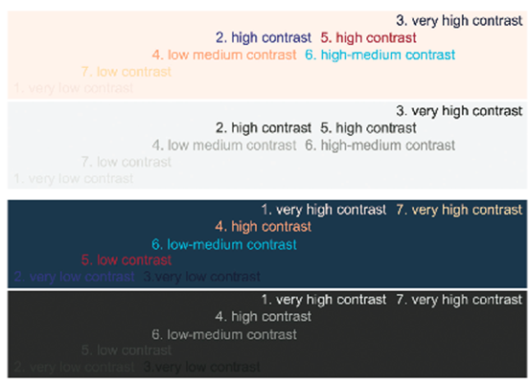
Presentation Design
Text must be easily readable (font size, contrast)
Whitespace; uncluttered
Consistency
Alignment
Design proportions (balance)
Simplicity
Use of colours
Limited - linked to theme/topic
Minimize scrolling
Test in different browsers
Plan for monitor and mobile devices
Remember that you have no idea on what size screen I will be assessing your site

Slide 10
Interaction Design
Navigation must be clearly laid out and consistent
Intuitive – should not need be announced as MENU
Include prominent “home” link on menu
Avoid saying: click here
All links should be working

Slide 11
Information Design (the content)
Precedence (Guiding the eye) – visual hierarchy (text, graphics, whitespace) – visual scanning
What is important (e.g. size of headings)
What is peripheral
Structure
Content logically presented
Effective writing (e.g. no long text blocks)
Short and concise information
Good use of language and no spelling/grammar errors
Minimalistic – few meaningful visuals, rather than many small pictures
Consider load time

Slide 12
Common elements of a page
Page header
First thing user sees – so plan it well
Should be common theme throughout site
Top 100 – 150 pixels
Main navigation
Usually 5 – 6 links
Typically near top or at left of page
Secondary navigation
Second level of links
Page title (main heading)
Page footer
Usually contains links to things like terms and conditions
Should not be a repeat of main navigation

Slide 13
Font size and line length
For ideal reading text should have 30 – 50 characters per line
Longer lines makes text harder to read
Therefore page width is usually divided into columns to limit line length
Typically
Main text in middle column
Second and third (narrower) columns for additional, related text
Beware of having font size too small

Slide 14
Page alignment
If page takes up 100% of screen width, page alignment is irrelevant
But then the layout must contain a number of columns
Do not force your audience to read left to right – using the full width of the screen for a single column
For pages less than 100% width, center alignment is more balanced, especially on wide screens
Might still need at least 2 columns anyway to make it easier on the eye
This is not referring to text alignment – DO NOT make all your text centered on your page

Slide 15
Using Whitespace
Can be used to help that your page elements does not seem cluttered
Padding
Adds space between element and its border
Margin
Adds space between elements (outside the border)
If there is no border, margin and padding often have the same effect (but not always).
Beware of wasted “prime” screen area – because of too much padding/margin around elements

Slide 16
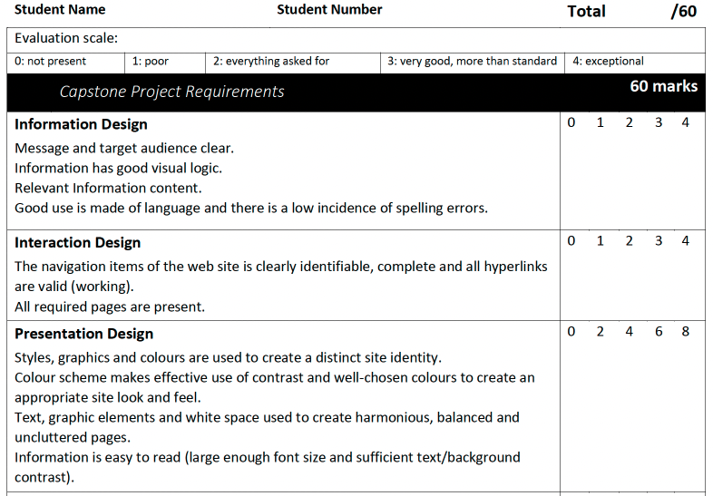
Measuring your website
Mark allocation
Average website will give you around 50%
Rubric items:
Information design
Interaction design
Presentation design

Slide 17
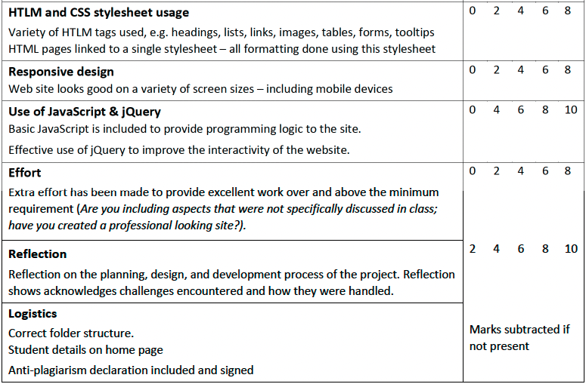
Measuring your website
Rubric items:
HTML and CSS usage
Responsive design
Use of JS & jQuery
Effort
Logistics

Slide 18
Submitting your capstone project
Due Friday 13 June (14:00)
Remember to check the following
Your name, surname and student number must be somewhere on the home page
One of the other pages must contain a declaration that the project is your own work (blank declaration available on Funda)
Submit on Funda– test your site before you zip and submit
After submission
Keep an eye on your emails – you may be contacted to book a review meeting

Slide 19
Almost done
No more Friday sessions for WRWV201
Put the due date for the capstone project in your calendar – submit on time
Give the project the time it should get:
Time to plan the design
Time to implement (average project vs effort….)
Check at least the following
All links should work
All images should show (use relative paths)
Does it still look good on a smaller screen?
Add signed declaration to a page on your site

